Slide 1

BSA College of Engineering
& Technology, MATHURA
APPROVED BY AICTE & AFFILIATED TO AKTU, LUCKNOW
Established & Governed by Shri Agrawal Shiksha Mandal
Chatify: Real-Time Chat Application
Mini Project (KCS752)
A report submitted to partial fulfillment for the award of
Degree of B.Tech in CSE
Batch : 2021-25
Presented to :
Dr. Durga Puja, AP CSA
Presented by:
Vishesha Sanadhya (2100650100116)
Rajkumar Singh Chaudhary (2100650100082)

Slide 2

Chatify: Real-Time Chat Application
Chatify is a powerful cross-platform messaging app that enables seamless real-time communication. With secure user authentication, rich text and multimedia sharing, and high-quality audio/video calls, it is the ultimate tool for social, customer support, and team collaboration needs.
from:
Vishesha Sanadhya (2100650100116)
Rajkumar Singh Chaudhary (2100650100082)

Slide 3
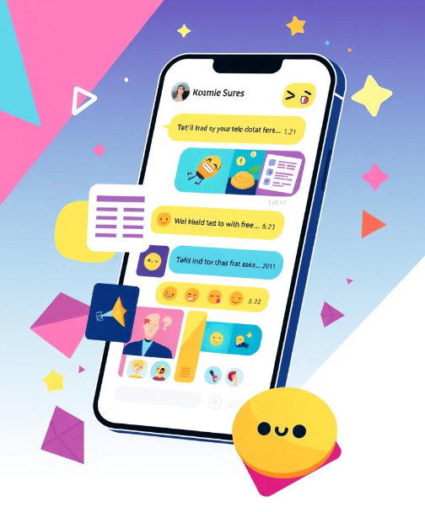
Introduction
A real-time chat application is a platform where users can communicate with each other instantly through messages, images, videos, or files. The messages are exchanged in real-time, meaning they are sent and received with minimal delay, creating a seamless user experience. This is widely used in messaging apps, customer support systems, and social media.
Additionally, the application incorporates voice and video call features, enabling real-time communication beyond text.

Slide 4

Objectives
Instant messaging: Users can send and receive text messages in real-time without noticeable delays.
User authentication: Secure login options, including email/password and social media integration (Google, Facebook).
Media sharing: Users can share images, videos, and files within the chat.
Push notifications: Informing users when new messages arrive, even when the app is closed.
Voice and video calling: features allow users to communicate face-to-face or via voice in real-time.

Slide 5

Methodology
Planning and Requirement Analysis
Defined project goals: real-time messaging, media sharing, user authentication.
Selected tech: Flutter, Dart, Firebase and real-time capabilities.
UI/UX Design
Created wireframes and prototypes for seamless user experience.
Designed intuitive UI using Flutter’s material design components.
App Development
Frontend (Flutter/Dart): Built UI components and implemented logic.
Backend (Firebase): Integrated Firestore for real-time messaging, Authentication, Cloud Storage, and Push Notifications.
Integrated ZEGOCLOUD for real-time voice and video call functionality, providing a seamless user experience for both one-on-one and group calls.

Slide 6

Technology Used
Flutter: Flutter is an open-source UI toolkit by Google that allows developers to build natively compiled applications for mobile, web, and desktop from a single codebase. It’s ability to support multiple platforms.
Dart: Dart is the programming language used to build Flutter applications. It is optimized for building user interfaces with features like a reactive framework and a just-in-time compiler, making development fast and efficient.
Firebase: Firebase is a cloud platform by Google offering a suite of services, user authentication services, cloud storage, and other backend functionalities.
ZegoCloud: Provides real-time voice and video calling capabilities, enabling high-quality communication within the app.

Slide 7

Hardware and Software Requirements
Operating System (OS): Windows, macOS, or Linux (for development)
Mobile OS Compatibility: Android 5.0 (Lollipop) or later for Android app development
Memory (RAM): 4 GB (minimum) or 8 GB or higher recommended for better performance
System Storage: 2 GB for Flutter SDK, Dart SDK, ZEGOCLOUD SDK, and app dependencies
Development Environment:
Flutter SDK: For cross-platform development
Dart SDK: For building app logic and UI
ZEGOCLOUD SDK: For real-time voice and video calling integration
Firebase Tools: Firebase CLI for backend services (Authentication, Firestore, Cloud Storage)

Slide 8
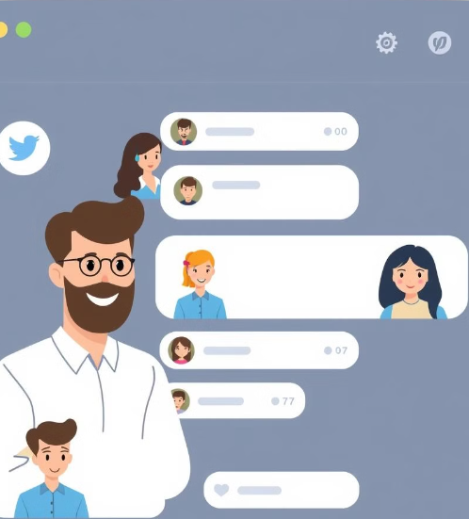
Real-World Application
Social Media Platforms: Enables instant communication and media sharing among users.
Team Collaboration Tools: Facilitates real-time coordination and file sharing in professional settings.
Customer Support Systems: Provides immediate assistance and resolution for customer inquiries.
Educational Platforms: Enhances interaction between students and educators through real-time discussions.
Healthcare Communication: Supports telemedicine with secure, real-time consultations and follow-ups.

Slide 9
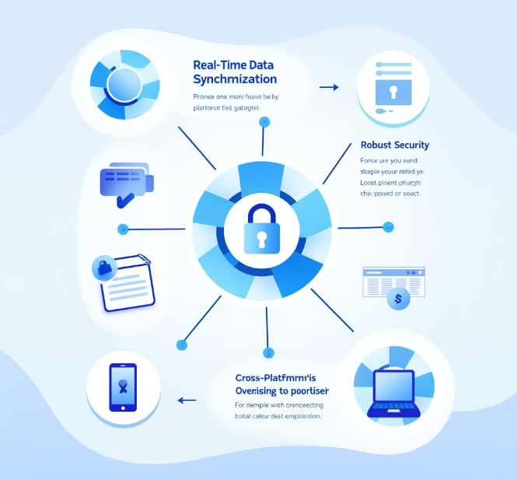
Challenges Faced
Real-Time Data Synchronization:- Ensuring consistent message delivery and updates across all devices in real-time.
Scalability and Performance:- Managing a high volume of users and messages while maintaining low latency and optimal app performance.
Media Handling:- Efficiently handling the upload, download, and display of images, videos, and other media types.
Cross-Platform Support:- Ensuring seamless functionality and consistent user experience across Android, iOS, and web platforms.
Video/Audio Calling Integration:- Implementing reliable video and audio calling features using platforms like ZEGOCLOUD, while ensuring low latency and good call quality.

Slide 10
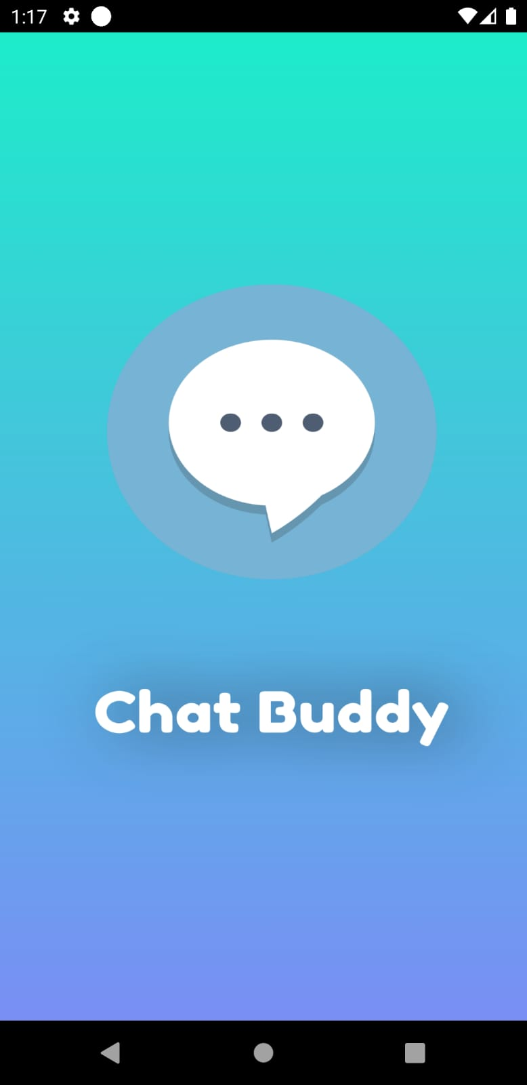

Slide 11
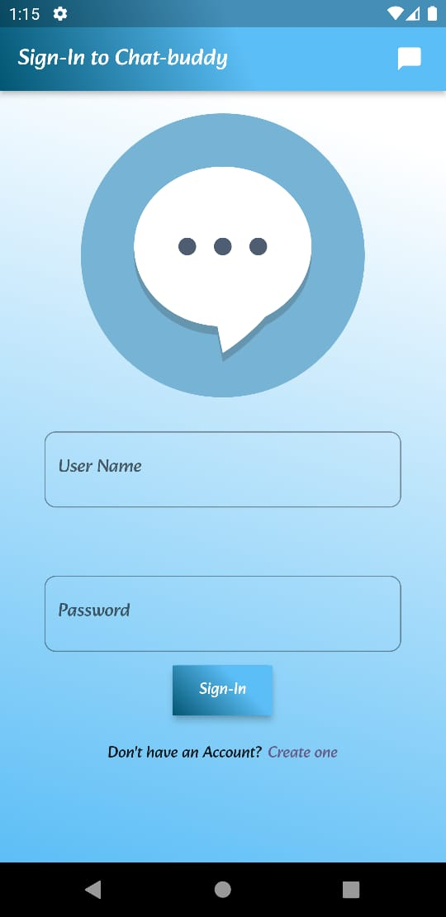

Slide 12
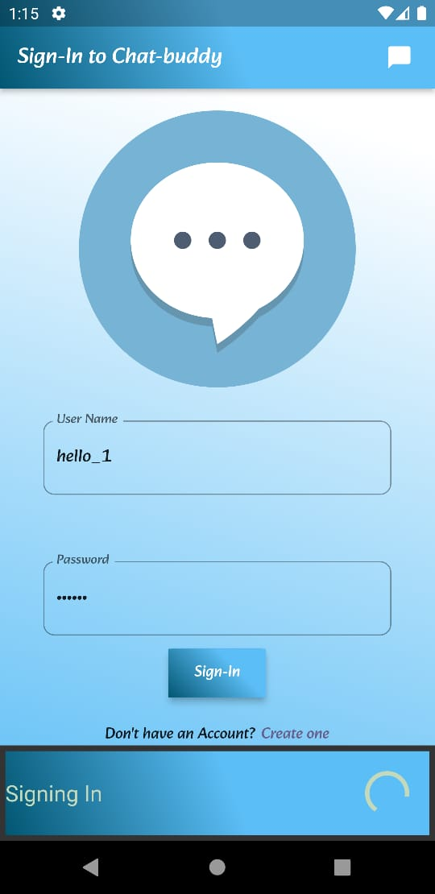

Slide 13
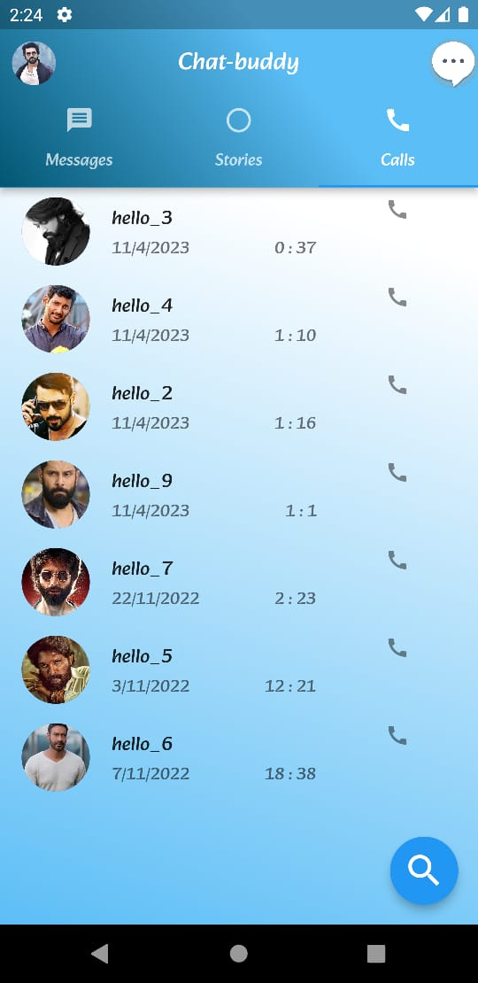

Slide 14
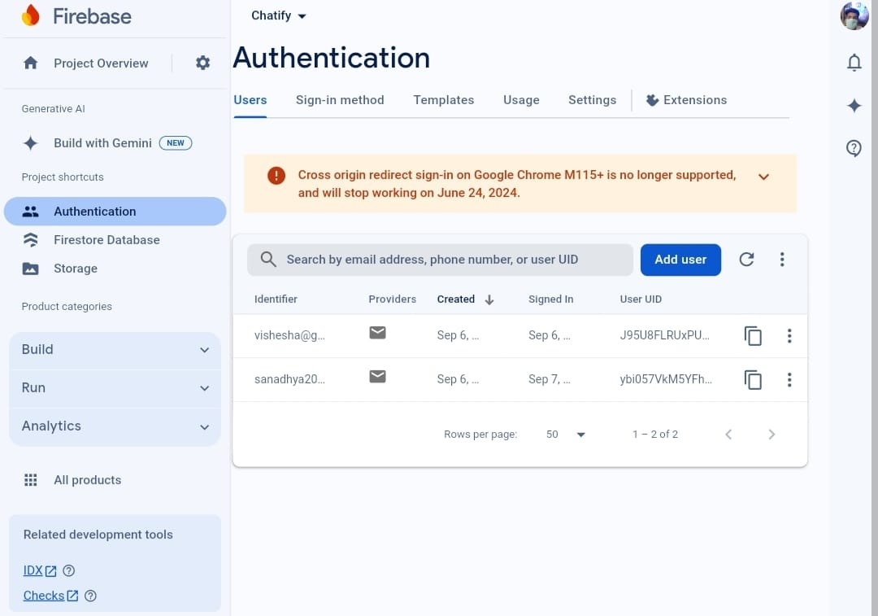

Slide 15
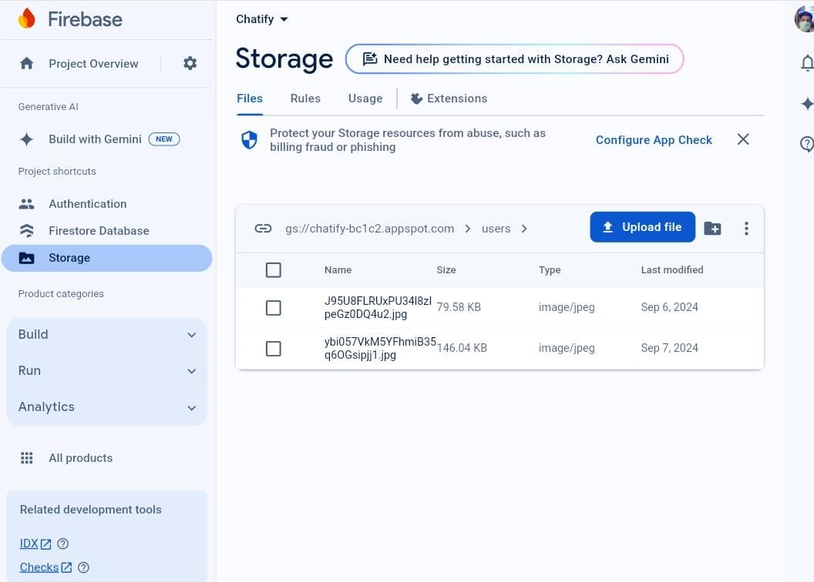

Slide 16
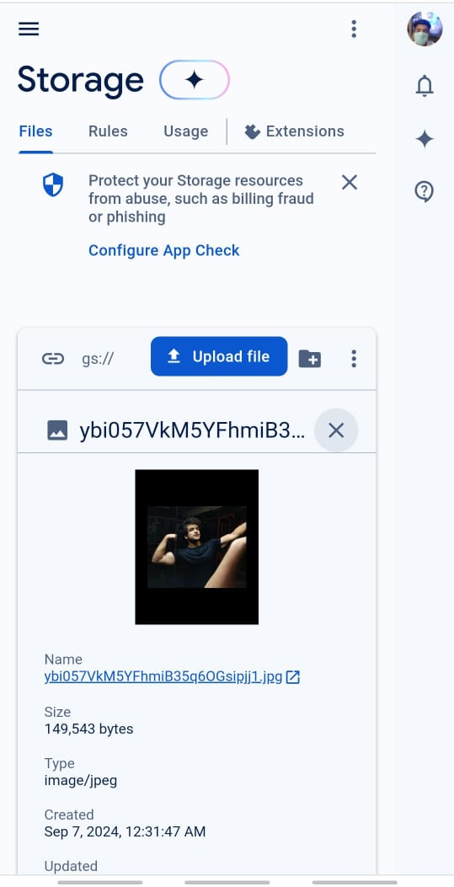

Slide 17
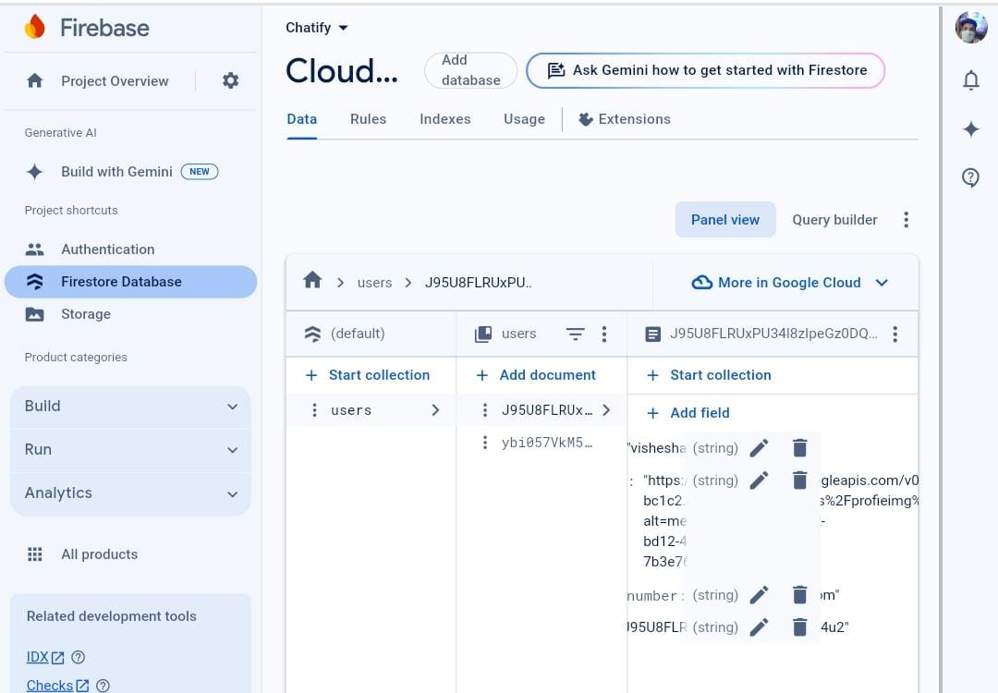

Slide 18
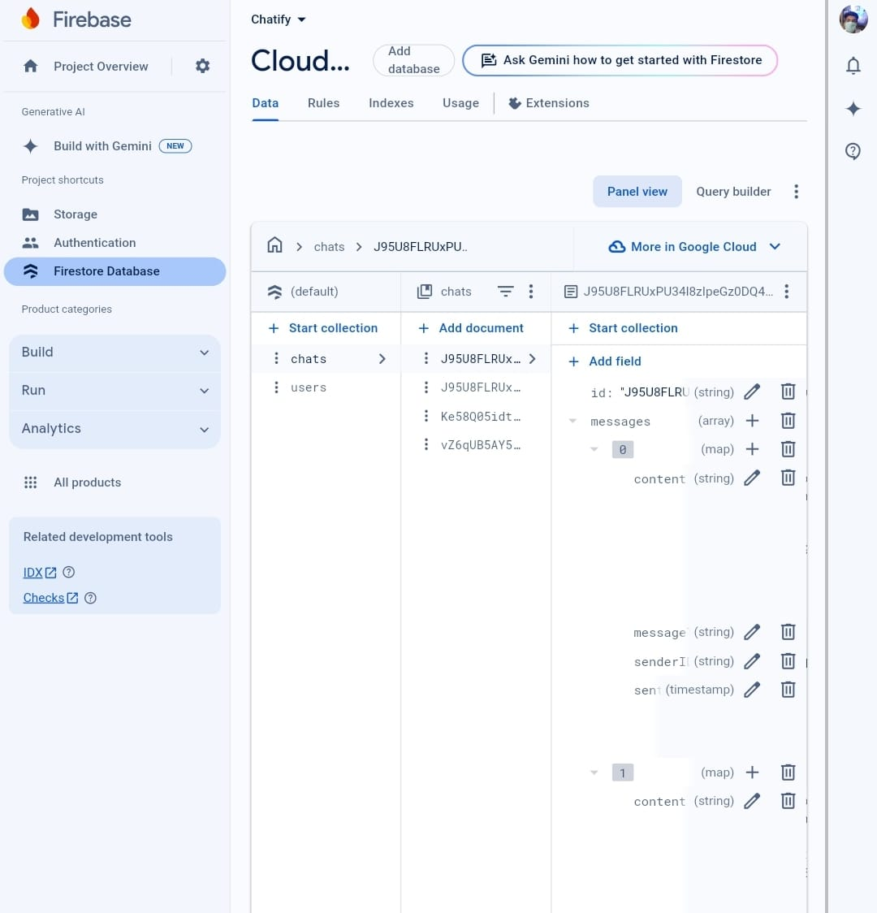

Slide 19

Future Scope
Group Chats: Implement group conversations with support for media sharing and notifications.
Message Reactions and Threads: Allow users to react to messages or create sub-threads within conversations.
Read Receipts: Advanced user interaction tracking for message read and delivery statuses.
End-to-End Encryption: Ensure high security and privacy for user communications, following encryption standards
.Conference Calls: Allow multiple users to join voice or video calls at once.

Slide 20
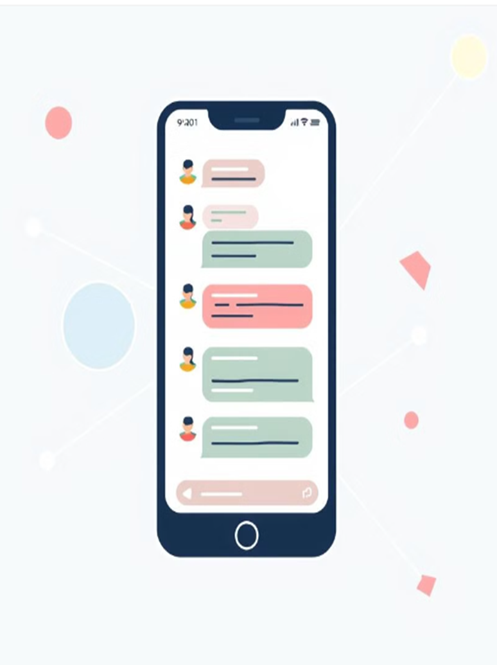
Conclusion
The real-time chat application developed using Flutter, Dart, and Firebase effectively demonstrates the power of modern technologies in creating a seamless, cross-platform communication tool. The project successfully integrates real-time messaging, media sharing, and user authentication, addressing various real-world needs such as social networking, team collaboration, customer support, and more.

Slide 21

Thank You
Thank you for your time and valuable feedback. Your insights will help shape the future of Chatify.

